Slide 1
Unit 1 Lesson 9
Practice Problems

Slide 2
This Photo by Unknown Author is licensed under CC BY-NC

Slide 3
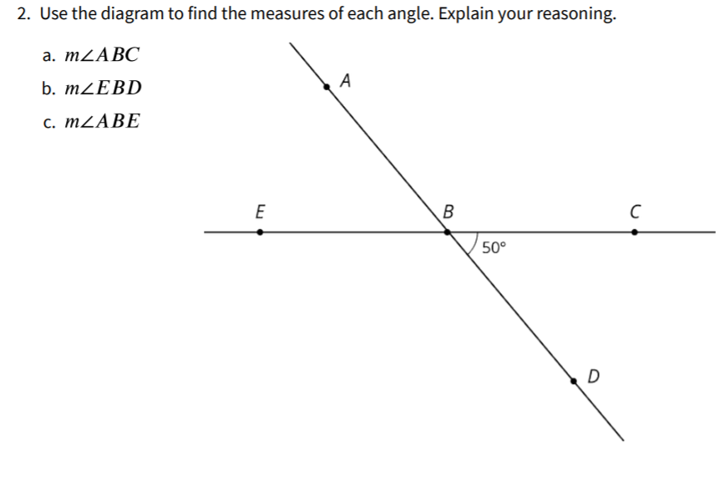

Slide 4
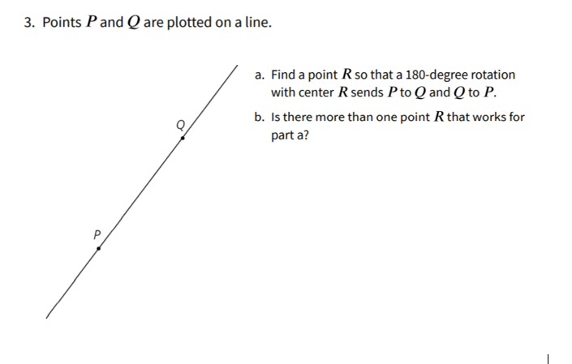

Slide 5
